Slide 1

Top 10 Articles in PEM for 2020
J Gravel, MD, MSc, FRCPC
Sunday 31 January 2021

Slide 2



ConfliCt of Interest
None

Slide 3

Objectives
For 2020
Top 10 PEM articles
+ 1 bonus

Slide 4
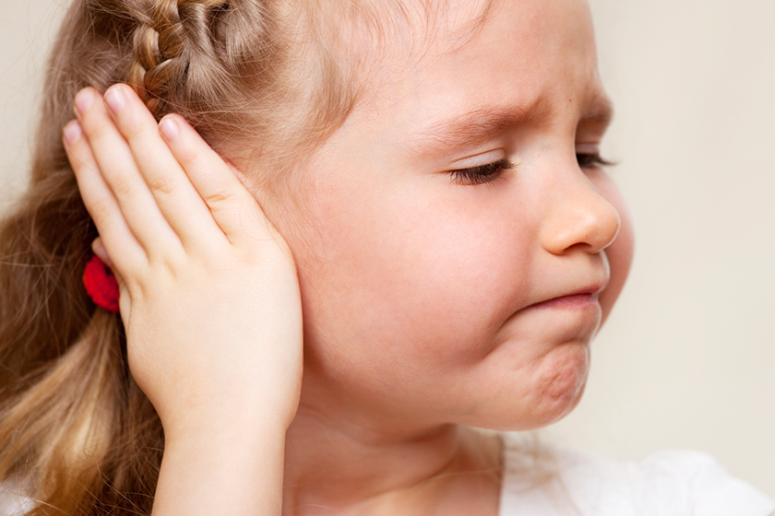
Case scenario #1
18 months old girl with a ear infection

Slide 5
Case scenario #1
A GIRL with an acute otitis media
What is the best medication for fever and for pain?
Acetaminophen
Ibuprofen
No difference

Slide 6
Introduction
Previous systematic reviews
  Ibuprofen = acetaminophen
  1-18 years old

Slide 7
Objective
Compare the antipyretic, analgesic, and safety profiles of acetaminophen with ibuprofen for the short-term treatment of fever or pain in children younger than 2 years.
Safety for < 3 months

Slide 8
Methods
Design: Systematic review and meta-analysis of randomised and non-randomized control trials (case-control, cohort).
Data sources:
  Trial registries up to March 2019

Slide 9
Methods
Inclusion criteria:
  Acetaminophen vs. Ibuprofen
  Children younger than 2 years old
  Outcomes:
    Pain or fever at 4 hours
    Safety at 28 days
Notes:
Restricted to children younger than 2 or could provide information about chldren younger than 2. Also possible if > 50% are younger than 2

Slide 10
Methods
Analyses:
  Sub analysis
    High vs low doses
    Less than 6 months
    Varicella
Notes:
Aceta > or < 10mg/kg ibu >or< 5 mg/kg

Slide 11
Results
RCT
28 450 children
Pain 4 studies
Fever 9 studies
Safety 9 studies
Non-RCT
212 688 children
Pain 0 studies
Fever 2 studies
Safety 8 studies

Slide 12
Results. Fever at 4 hours

Slide 13
Results. Fever at 4 hours
Notes:
Results similar when for high dose and low doses

Slide 14
Results. Fever at 4-24 hours
Notes:
Results similar when for high dose and low doses

Slide 15
Results. Pain at 4 hours

Slide 16

Results. Other outcomes
Side effects | RCT | Non-RCT
Serious Adverse event | 1.4 vs 1.3 % | 0 vs 0%
Kidney involvement | 0.1 vs 0.1% | 0 vs 0.04%
Hepatotoxicity | 0.9 vs. 1.7%
Asthma | 0.2 vs. 0.3%
GI bleeding | 0.02 vs. 0% | 0 vs 0%
Soft tissue infection |  | 0 vs. 0.04%

Slide 17
Limitations
Not enough information for children < 6 months
Few patients in the pain study

Slide 18
Conclusion
Ibuprofen use was associated with reduced temperature and less pain within the first 24 hours than acetaminophen use.
Similar safety profile

Slide 19
Case scenario #1
A GIRL with an acute otitis media
What is the best medication for fever and for pain?
Acetaminphen
Ibuprofen
No difference

Slide 20
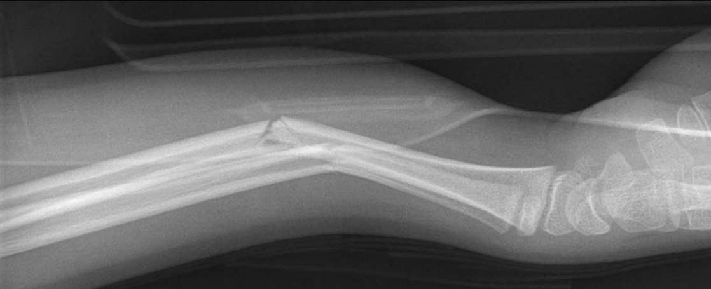
Case scenario #2 …
A teenage girl with a displaced arm fracture
12 years old girl
Pain 10/10

Slide 21
Case scenario #2
A teenage girl with a displaced arm fracture
She needs a reduction soon. Can you give her something for pain?
  Yes
  no

Slide 22
Introduction
Pre-procedural opioid = sedation adverse event
ACADEMIC EMERGENCY MEDICINE 2020;27:217–227

Slide 23
Objectives
Examine whether the risk of sedation-related adverse events changes with the timing of opioid administration in children undergoing procedural sedation in the ED
ACADEMIC EMERGENCY MEDICINE 2020;27:217–227

Slide 24
Methods
Secondary analysis of a prospective cohort Setting:
  6 Canadian EDs
  2010-2015
ACADEMIC EMERGENCY MEDICINE 2020;27:217–227

Slide 25
Methods
Participants
  Children 0-18 years old
  Procedural sedation
  Received opioid before the procedure
ACADEMIC EMERGENCY MEDICINE 2020;27:217–227

Slide 26
Methods
Outcomes
  Oxygen desaturation
  Vomiting
  Need for positive pressure ventilation
ACADEMIC EMERGENCY MEDICINE 2020;27:217–227

Slide 27
Methods
Risk factors:
  Timing of opioid administration (in minutes)
Confounding factors:
  Age
  Type of opioid
  Sedation
  Procedure
ACADEMIC EMERGENCY MEDICINE 2020;27:217–227

Slide 28
Results
6295 children
1805 eligible
Notes:
The median age was of 11 years old

Slide 29
Results… oxygen desaturation
Desaturation
No event
8.7%
30 min before sedation (13.8%)

Slide 30
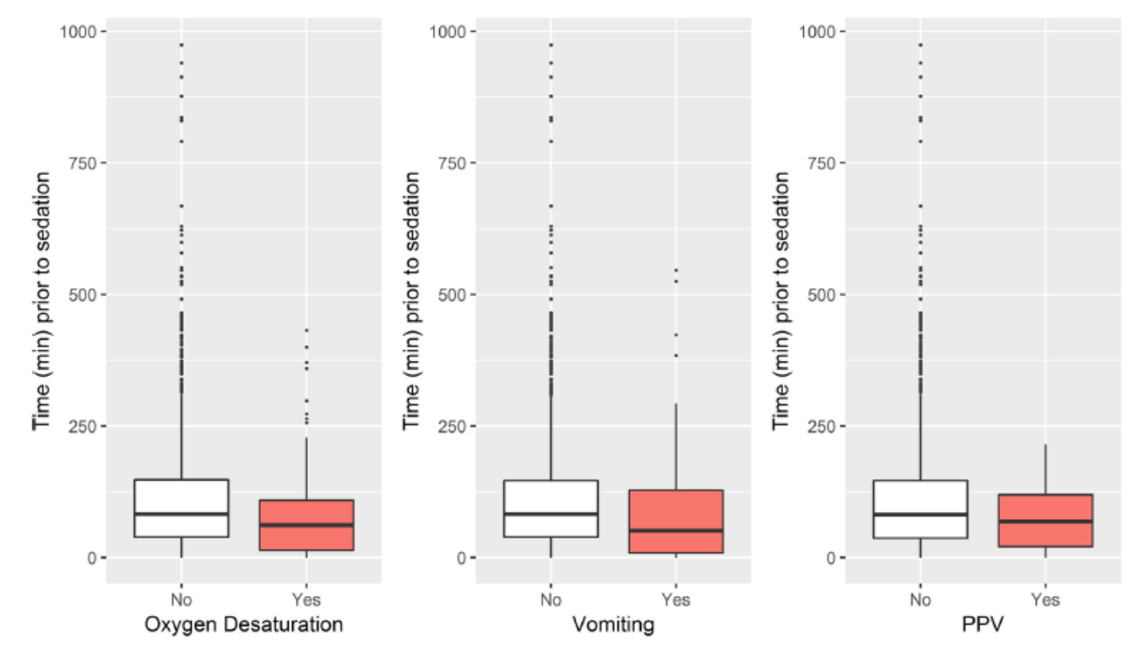
Results… Vomiting
Vomiting
No event
6.6%
30 min before sedation (12.0%)

Slide 31
Results… Positive pressure ventilation
PPV
No event
2.4%
30 min before sedation (3.3%)

Slide 32
Results
Multiple variables logistic regression:
  Timing is associated to adverse events
  Fentanyl less adverse events
ACADEMIC EMERGENCY MEDICINE 2020;27:217–227

Slide 33
Limitations
Observational study
Dosage or route not included in the model
Multiple doses not measured
ACADEMIC EMERGENCY MEDICINE 2020;27:217–227

Slide 34
Conclusions
Opioid given closer to the reduction is at higher risk of adverse events
Fentanyl showed less adverse events
ACADEMIC EMERGENCY MEDICINE 2020;27:217–227

Slide 35
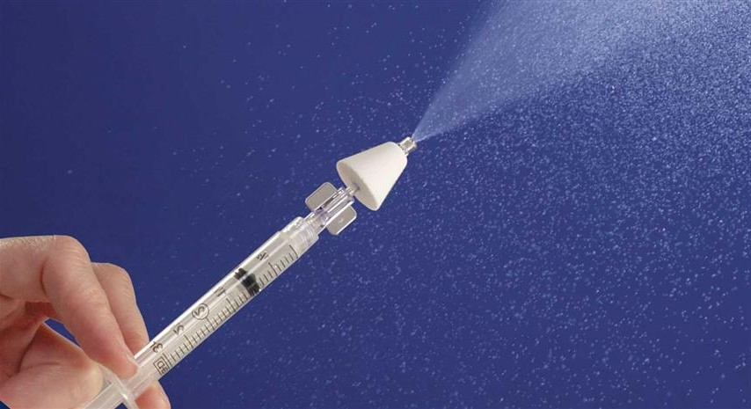
Case scenario #2
A girl with a broken bone
She needs a reduction soon. Can you give her something for pain?
  Yes
  no
Fentanyl

Slide 36
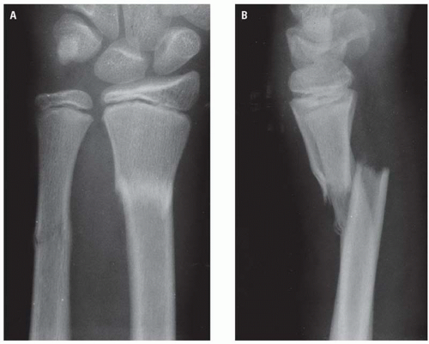
Case scenario #3
He just had a small sandwich
15 year old boy
Just ate before ED visit

Slide 37
Case scenario #3
He just had a small sandwich
Can we do the procedural sedation now?
No wait 2 h post meal
No wait 4 hours post meal
No wait 8 hours post meal
Yes

Slide 38
Introduction
Procedural sedation in the ED
    AAP and Anesthesiologist
      Clear liquid >2 hours
      Breast milk > 4 hours
      Ligth meal >6 hours Heavy meal 8 hours
    ACEP No fasting

Slide 39
Objective
To examine adverse outcomes and departmental efficiency when fasting guidelines are not considered during pediatric emergency department visit

Slide 40
Method
Design:
  Retrospective chart review
Setting:
  Tertiary care pediatric ED (90 000 visits/year)
  2011-2018

Slide 41
Inclusion criteria:
  Children aged 0-18 years
  Procedural sedation for orthopedic procedure
Exclusion criteria:
  Multiple procedure
  Missing data

Slide 42
Exposure:
  Meet ASA guidelines
  Don’t meet the guidelines
  Wait to meet the ASA guidelines

Slide 43
Outcomes:
  Time points:
    Length of stay
    Time from arrival to procedure
    Time of procedure
    Time to recovery
  Adverse events

Slide 44
Results
ASA guideline
Don’t meet
wait

Slide 45
Results
ASA
Don’t meet
Wait
+84 min
Groups similar on
Age, sex
Procedure
Medication for sedation

Slide 46
Results
ASA
Don’t meet
Wait
671 555 1448
Adverse event probability 1.8% 2.3% 1.3%
Notes:
Adverse events were similar

Slide 47
Limitations
Selection biases
Multiple reasons for delays
Adverse events---are they charted ?
Notes:
Sicker children were at higher risk of LP

Slide 48
Conclusions
Length of stay in the ED is prolonged by 1.5 hours to meet ASA fasting guidelines
No impact on adverse events

Slide 49
Case scenario#3
He just had a small sandwich
Can we do the procedural sedation now?
No wait 2 h post meal
No wait 4 hours post meal
No wait 8 hours post meal
Yes

Slide 50
Case scenario #4
Refractory asthma crisis
6 year old girl (18Kg) with an asthma crisis
Received
  Salbutamol: 5 puffs q 20 min x 3
  Atrovent: 8 puffs q 20 min x 3
  Decadron: 10mg PO

Slide 51
Case scenario #4
Refractory asthma crisis
Improved but still sick
Not sick enough to mandate an IV
Could you give MgSO₄ without an IV ?

Slide 52
Introduction
MgSO₄ is effective but needs an IV access
Nebulized MgSO₄ could be a solution to decrease hospitalisation

Slide 53
Objective
Evaluate the effectiveness of inhaled magnesium in children who presented to EDs with an acute asthma exacerbation and remained in moderate or severe respiratory distress after initial therapy.

Slide 54
Methods
Multi-centre prospective double blinded RCT
7 PERC EDs
2011-2019

Slide 55
Methods
Participants inclusion:
  2-17 years old
  Past medical history of asthma
  PRAM >4 after 1 hour of Treatment
Exclusion:
  Already hospitalised
  IV Magnesium
  Comorbidities

Slide 56
Methods
Intervention:
  600 mg of nebulized MgSO₄ + Salbutamol q 20 min x 3
Control:
  Nebulized Salbutamol q 20 min x 3

Slide 57
Methods
Outcomes
  Primary:
    Hospitalisation within 24 hours
  Secondary:
    PRAM score 60-120-180-240 minutes
    Respiratory rate Oxygen saturation
    Adverse events

Slide 58
Results

Slide 59
Results
93%
received 3 Tx
Similar

Slide 60
Results.. hospitalisation
43.5 vs 47.7

Slide 61
Results… secondary outcomes
No difference

Slide 62
Results… secondary outcomes
No difference

Slide 63
Results… subgroup analyses

Slide 64
Adverse events
Notes:
There were more adverse events in the Mg group but this consist mainly mouth and nose problems.
There were more serious adverse events in the placebo group and they all consited of ICU admission

Slide 65
Limitations
Decision to hospitalised is not standardized
The confidence interval crosses a difference of 10%
  -5% (95%CI: -13 to 2%)

Slide 66
Conclusion
Among children with refractory acute asthma in the ED, nebulized magnesium with albuterol, compared with placebo with albuterol, did not significantly decrease the hospitalization rate for asthma within 24 hours.

Slide 67
Case scenario #4
Refractory asthma crisis
Improved but still sick
Not sick enough to mandate an IV
Could you give MgSO4 without an IV ?
NO

Slide 68
Case scenario #5
Is this a urinary tract infection?
5 months old boy with fever without a source

Slide 69
Case scenario #5
Is this a urinary tract infection?
Urinalysis:
  Disptick: Nitrite – leucocyte esterase -
  Microscopy: Leucocyte 10-20 No bacteria
Is this a UTI?
  No
  Yes

Slide 70
Objective
Calculate the interval likelihood ratio of urinalysis components to estimate the posttest probabilities of UTIs in children, 2 years of age

Slide 71
Methods
Retrospective cross-sectionnal study
Single pediatric ED in New York
2011-2019

Slide 72
Methods
Participants:
  < 2 years old
  Urinalysis + culture
  Performed in the ED

Slide 73
Methods
Primary outcome: UTI
  Single pathogen > 50 000 CFU/mL
  Contamination
    2 pathogens
    bacteria not commonly considered pathogens

Slide 74
Methods
No information on method of sampling
Retrospective collection through medical charts
Some patients did not have a microspcopy because dipstick was negative.
Notes:
646 patients did not have a microscopy because the labstuck was negative. Of these 26 had a positive culture that was classified as a contaminent.

Slide 75
Results

Slide 76
Results
Pre-test probability 9.2%
Notes:
Those were all minor side effects

Slide 77
Results

Slide 78
Results

Slide 79
Limitations
No information on specimen collection technique
646 patients without a microscopy
Notes:
Local guideline suggests catheterization and no bag

Slide 80
Conclusion
The probability of UTI significantly increases with
  3+ leukocyte esterase
  positive nitrite results
  3+ protein
  20 to 50 or higher WBCs per HPF
  many bacteria on urinalysis.
No single item is perfect

Slide 81
Case scenario #5
Is this a urinary tract infection?
Urinalysis:
  Disptick: Nitrite – leucocyte esterase -
  Microscopy: Leucocyte 10-20 No bacteria
Is this a UTI?
  No
  Yes
Probably NOT

Slide 82
Case scenario #6
The resident asked me to do the LP
3 weeks old child with fever for 6 hours
Looks good at physical exam
Positive urinary test

Slide 83
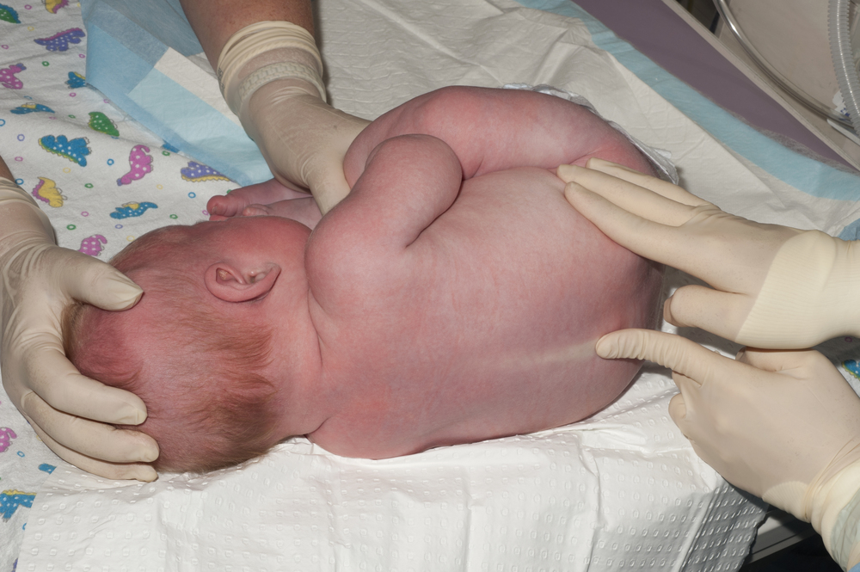
Case scenario #6
The resident asked me to do the LP
Do you do the lumbar puncture ?
  Yes
  No

Slide 84
Objectives
Determine the prevalence of coexisting Bacterial meningitis in neonates with culture-proven Urinary Tract Infection and to identify risk factors for BM in those patients.

Slide 85
Methods
Retrospective cross-sectionnal study
Single pediatric ED in Spain (105 000 visit/ year)
2001-2017

Slide 86
Methods
Participants:
  < 29 days of age years old
  UTI (> 10 000 CFU/mL and a positive analysis)
  Diagnosed in the ED
  LP performed

Slide 87
Methods
Primary outcome: Bacterial meningitis
  Single pathogen
  Pleocytosis and Negative culture but received Atb before LP

Slide 88
Methods
Risk factors
  Age
  High risk medical history
  Fever
  Not well-appearing at the ED
  WBC count, absolute neutrophil count, CRP and PCT.

Slide 89
Results

Slide 90
Results… prevalence of bacterial meningitis
371 children
44 (12% Bacteremia)
5 (1.4%) Bacterial meningitis
4 positive cultures
1 probable meningitis
Notes:
The fifth infant had probable BM: a 23-day old male who presented with fever, irritability and abnormal PAT
at evaluation. LP was unsuccessful at ED after several attempts. The patient was admitted to intensive care unit because of suspected
urosepsis; LP was repeated 8 hours later after administration of antibiotics, obtaining a bloody CSF

Slide 91
Results
Notes:
No difference

Slide 92
Results

Slide 93
Results… risk factors
Notes:
The only clincal risk factor identified was not weel appearing that was a strong predictor of meningitis

Slide 94
Results… risk factors
Procalcitonin >0.35 ng/mL
Sensitivity 100%
Specificity 44%
PPV 4.1%
NNV 100%

Slide 95
Limitations
Only 5 patients with bacterial meningitis
Retrospective study

Slide 96
Conclusion
The probability of bacterial meningitis in children < 29 days with UTI is approximately 1%
General appearance could help identify meningitis

Slide 97
Case scenario #6
The resident asked me to do the LP
Do you do the lumbar puncture ?
  Yes
  No
Shared decision making with the familly

Slide 98
Case scenario #7
Is this meningitis bacterial?
3 year old child
Fever, vomiting, stiff neck for 8 hours
Lumbar puncture:
  120 WBC/mL
  Protein and glucose normal
  Gram stain -
Notes:
Summer time

Slide 99
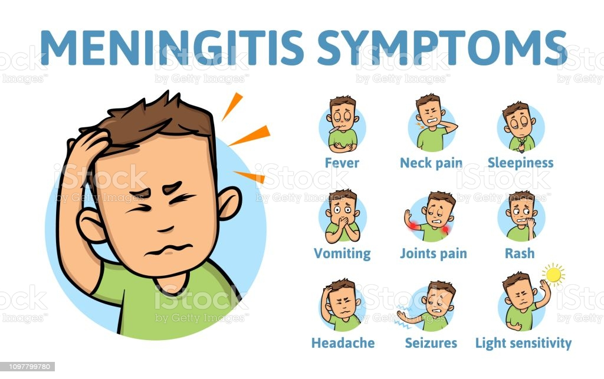
Case scenario#7
This is meningitis. Is it bacterial?

Slide 100
Introduction
Most meningitis are viral
Bacterial meningitis are very dangerous
Almost always admitted for antibiotics
Notes:
With the advent of many vaccines, most meningitis are viral

Slide 101
Objective
Develop and validate a score to distinguish bacterial meningitis from aseptic meningitis in children with pleocytosis when initially evaluated at the ED.

Slide 102
Methods
Multiple center cohort study
Settings
  25 EDs in Spain
  Retrospective 2011-2016
  Prospective 2017-18

Slide 103
Methods
Participants:
29 days to 14 years old
CSF pleocytosis and data on all the following:
    blood and CSF bacterial cultures,
    white blood cell (WBC) count
    serum CRP, and procalcitonin.
Exclusion: Critically ill, purpura or Atb before LP

Slide 104
Methods
Primary outcome: Bacterial meningitis

Slide 105
Methods
Methods
Independent variables
  CSF
    ANC, WBC count, protein, glucose,
  Serum
    CRP, procalcitonin, WBC count, and ANC.

Slide 106
Methods
Methods
Procedure
  Derivation:
    Retrospective analysis of the charts
  Validation:
    Retrospective analysis of the charts

Slide 107
Methods
Analysis
  Derivation
    ROC curve for all variable
    Inclusion for AUC > 0.90
    B coefficient in logistic regression
  Validation
    Sensitivity/ specificity

Slide 108
Results…Derivation
1509 Children with pleocytosis
1341 aseptic
168 Bacterial
Excluded
488
1009 Children with pleocytosis
917 aseptic
92 Bacterial

Slide 109
Results…
Derivation

Slide 110
Results
Validation

Slide 111
Results biomarkers
Notes:
Serum biomarkers on multiple variable regression

Slide 112
Validation MSE >0
Sensitivity 100%
Specificity 77%

Slide 113
Limitations
Why a 7 points score if the threshold is 1?
Retrospective evaluation of all charts

Slide 114
Conclusions
Higher risk of bacterial meningitis for:
  Procalcitonin > 1.20 ng/mL
  CRP > 40 mg/L
  CSF neutrophile > 1000/μL
  CSF protein > 80 mg/dL

Slide 115
Case scenario #7
Is this meningitis bacterial?
3 year old child
Fever, vomiting, stiff neck for 8 hours
Lumbar puncture:
  120 WBC/mL
  Protein and glucose normal
  Gram stain -
We need the CRP and procalcitonin
Notes:
Summer time

Slide 116
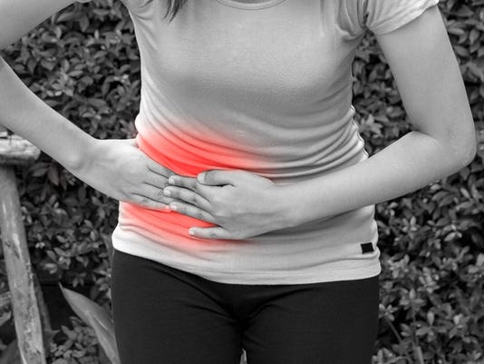
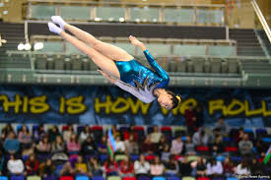
Case scenario #8
15 year old girl with abdominal pain
Uncomplicated appendicitis
Notes:
Ultrasound confirms and uncomplicated appendicitis.
The girl has a very important figure skating tournament in 5 weeks and ask if surgery is absolutely necessary

Slide 117
Case scenario #8
A GIRL with appendicitis
Can this girl avoid surgery?
1. No she needs it ASAP
2. Yes she can have antibiotics instead

Slide 118
Last year

Slide 119
Conclusion
Non-operative management of appendicitis is a reasonable approach but
  8% risk of immediate need of surgery
  20% risk of appendicitis reccurence at 1 year.

Slide 120
Objective
Determine the success rate of nonoperative management and compare differences in disability days, health-related QOL, medical/surgical complications, and satisfaction between nonoperative management and surgery in children

Slide 121
Methods
Multi-centre prospective non-randomized trial
10 pediatric Hospitals in the MidWest
2015-2018

Slide 122
Methods
Multidisciplinary Group Involvement
  Patients, families,
  Surgeons, ED physicians, pediatricians
  Nurses
  Prayer, educator
Strong feeling related to operating or not
NO RCT

Slide 123
Methods
Participants inclusion:
  7-17 years old
  Radiologically confirmed uncomplicated appendicitis
  WBC 5-18 000
  Less than 48 hours of symptoms

Slide 124
Methods
Surgery:
  Antibiotics (Pip-Tazo)
  Laparoscopic intervention in less than 12 hours
No surgery:
  Antibiotics (Pip-Tazo) for at least 24h than Clavulin for total 7 days
  Diet when improved

Slide 125
Shared decision making with the familly

Slide 126
Methods
Outcomes
  Primary:
    Disability days during one year
    Success rate of non-operative management
  Secondary:
    Length of stay
    Complications
    Multiple others

Slide 127
Results
19% eligible
70% participated

Slide 128
Results
77%
75%

Slide 129
Results
Baseline
demographics

Slide 130
Results.. Primary outcomes

Slide 131
Results… secondary outcomes

Slide 132
Adverse events

Slide 133
Limitations
Only 19% eligible
Selection bias ? Not RCT

Slide 134
Conclusion
Non-surgical approach= 67% success rate
Fewer disability days at one year (between 2 and 6)

Slide 135
Case scenario #8
A GIRL with appendicitis
Can this girl avoid surgery?
1. No she needs it ASAP
2. Yes she can have antibiotics

Slide 136
Case scenario #8 A GIRL with appendicitis
Can this girl avoid surgery?
1. No she needs it ASAP
2. Yes she can have antibiotics
Shared decision making

Slide 137
Case scenario #9
A 2 years old who refuse to use her left arm
2 year old girl who refuse to move her left arm after being pulled by the arm by her father.
No swelling
Pain on movement of the arm

Slide 138
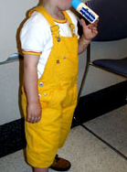
Case scenario #9
A 2 years old who refuse to use her left arm
Should you do an X-ray ?
Yes
No

Slide 139
Objectives
Assess the incidence of, and patient-level factors associated with, missed upper extremity fracture in children with a diagnosis of radial head subluxation.
DOI:https://doi.org/10.1016/j.annemergmed.2020.09.002

Slide 140
Methods
Multi-centre retrospective database study
52 pediatric Hospitals in the USA
2010-2018
DOI:https://doi.org/10.1016/j.annemergmed.2020.09.002

Slide 141
Methods
Participants:
  0 to 10 years old
  ED diagnosis: radial head subluxation
Exclusion:
  Transferred from another setting
  Fracture at the same visit
DOI:https://doi.org/10.1016/j.annemergmed.2020.09.002

Slide 142
Methods
Independent variables:
  Age, sex, race
  Insurance status
  Previous pulled elbow
  Radiological evaluation
  Pain medication in the ED
DOI:https://doi.org/10.1016/j.annemergmed.2020.09.002

Slide 143
Methods
Outcomes:
Primary:
  Upper extermity fracture in the 7 days
Secondary:
  Recurrence of radial head subluxation
  Radiography
DOI:https://doi.org/10.1016/j.annemergmed.2020.09.002

Slide 144
Results
88 466 pulled elbow

Slide 145
Results

Slide 146
Results.. radiography

Slide 147
Results
Missed fracture 247 (0.3%)
Elbow 147
Forearm/wrist 61
Shoulder/ clavicule 33
Humerus 9
Hand 2

Slide 148
Results… risk factors of missed fracture

Slide 149
Results…reccurence
8.7%

Slide 150
Limitations
Retrospective database
May have missed fracture who consulted elsewhere
DOI:https://doi.org/10.1016/j.annemergmed.2020.09.002

Slide 151
Conclusion
Missed fractures are uncommon
  Associated to
    more analgesia
    older age
    order of radiographs
DOI:https://doi.org/10.1016/j.annemergmed.2020.09.002

Slide 152
Case scenario #9
A 2 years old who refuse to use her left arm
Should you do an X-ray ?
Yes
No

Slide 153

Case scenario #10
A 6 years old who refuse to use her left arm
5 year old girl
6th pulled elbow.

Slide 154
Case scenario #10 she refuses to be manipulated
What can you do?

Slide 155
Introduction
Painful procedures are very common in Peds ED
No good intervention to reduce pain
IV Dexmedetomidine seems effective

Slide 156
Objective
Summarize the effectiveness of intra-nasal Dexmedetomidine for children undergoing painful and distressing procedures.

Slide 157
Methods
Design: Systematic review of randomised control trials
Data sources:
  Trial registries up to February 2019

Slide 158
Methods
Inclusion criteria:
  Intra-nasal Dexmedetomidine vs anything
  For a procedure
  Children younger 18
  Outcomes:
    Adequacy of sedation

Slide 159
Methods
Analyses:
  Plan for a meta-analysis
Impossible

Slide 160
Results…
IV insertion (6)
Laceration (1)
Dental (2)
Eye exam (3)
CT scan (3)
MRI (2)
Ultrasound (2)

Slide 161
Results…adequacy of sedation
Comparator
Chloral Hydrate
Oral Midazolam
IN Midazolam
Oral Dexmedetomidine
IN Ketamine
Oral Ketamine
IN Dex + Oral Ketamine
Favors dexmedetomidine
Neutral
Unfavourable

Slide 162
Results…sedation
Adequacy of sedation
Painful procedure 61% vs 47%
Non-painful procedure 84% vs 72%
Need for rescue medication 10% vs 28%
2 μg/kg better than 1 μg/kg
4 μg/kg better than 3 μg/kg
No difference atomiser vs. drops

Slide 163
Results…Adverse events
Bradycardia 2.2%
Hypotension 1.2%
Oxygen desaturation 0.5%
Vomiting 0.4%

Slide 164
Limitations
Important heterogeneity
Few studies of poor quality

Slide 165
Conclusion
Intranasal dexmedetomidine
Well tolerated
Provide sedative effects
Seems better than oral midazolam.

Slide 166
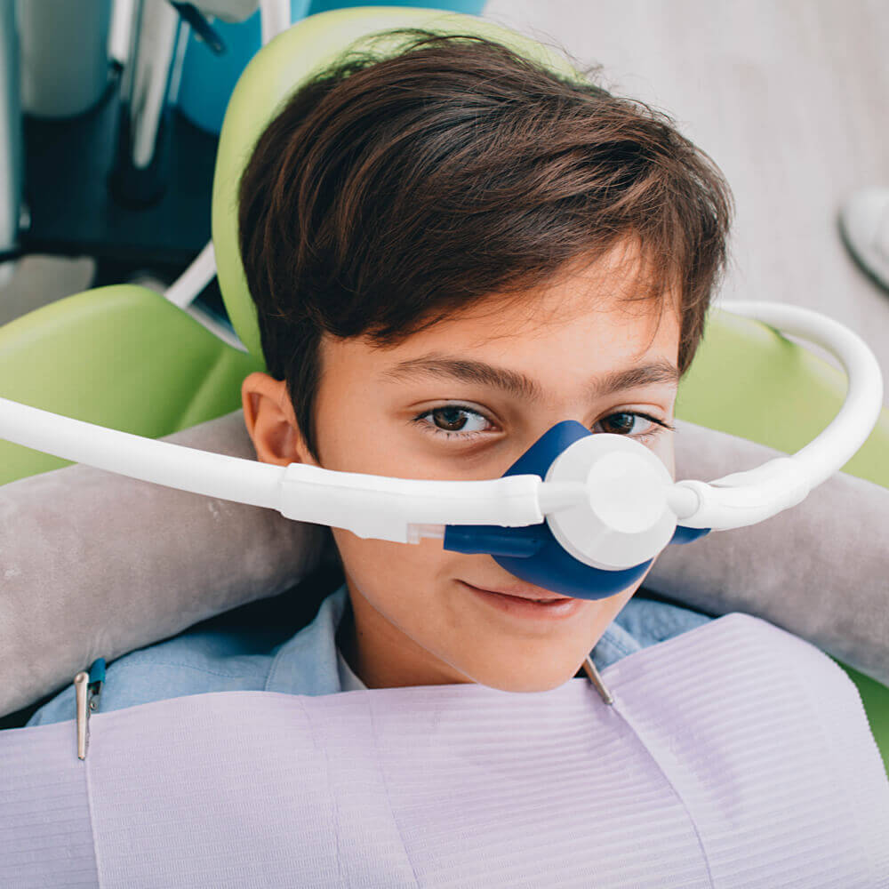
Case scenario #10 she refuses to be manipulated
What can you do?

Slide 167
Bonus article…..

Slide 168
Introduction
Painful procedures are very common in Peds ED
Pain and anxiety are related
Distraction and information could reduce pain

Slide 169
Objective
Compare the effects of watching a cartoon and an information video about IV insertion on the pain and fear levels of children aged 6-12 years.

Slide 170
Methods
Design: Randomized controlled trial
Setting: Single Pediatric ED in Istanbul
2017-18

Slide 171
Methods
Participants:
  6-12 years old
  Needs an IV

Slide 172
Methods
Interventions:
  Video (Before)
  Cartoon (During the procedure)
  Control
Notes:
The first group revcieved an animated video explaining the procedure before the IV
Watch one of two cartoons during the procedure

Slide 173

Methods
Outcomes:
  Pain Wong Baker FACES scale
  Fear Children Face Scale

Slide 174
Analysis
Sample size: 159 participants/group
  80% power to find
  0.20 effect size

Slide 175
Results…baseline characteristics
477 enrolled and 18 refused to participate
Similar
Notes:
There are no figure on flow of participants

Slide 176
Results…pain scores
Notes:
There are no figure on flow of participants

Slide 177
Results…FEAR scores
Notes:
There are no figure on flow of participants

Slide 178
Limitations
Pain and FEAR measured at 5 min post IV only
No blinding
Pain and fear are subjective

Slide 179
Conclusion
Cartoon or video decrease pain and fear associated to IV in children
Simple and cheap intervention

Slide 180
Take-home messages
Ibuprofen is better than acetaminophen in young children
Watch-out with pre-procedural opioid
No need for fasting before procedure
Dexmedetomidine may be useful for procedure
Distraction is effective for procedure

Slide 181
Take-home messages
Inhaled Mg sulfate is not effective
No item of the Labstick is perfect
1% meningitis in newborn with UTI
Bacterial meningitis (1000 neutro, procalcitonin, CRP, CSF protein)
65% success with Non surgical Tx of appendicitis
Pulled elbow is a clinical Diagnosis

Slide 182
They almost made it …..

Slide 183
Introduction
CPR coach improves CPR quality during resuscitation

Slide 184
Objective
Assess if the presence of a CPR Coach would improve adherence to PALS guidelines during simulated pediatric resuscitations.

Slide 185
Methods
Design: Secondary analysis of a simulation RCT
Intervention Coach or No coach
Outcome: Performance score on PALS adherence

Slide 186
Results…

Slide 187
Limitations
Retrospective study
No information on the clinical impact of a 5 points difference on the performance score

Slide 188
Conclusion
The presence of a CPR Coach correlated with an improvement in adherence to PALS guidelines during simulated pediatric resuscitations.

Slide 189
Introduction
Head CT involves radiation for the brain of children
MRI has limited accessibility and is longer to make

Slide 190
Objective
Evaluate the ability of a quick brain MRI protocol to detect clinically important traumatic brain injuries

Slide 191
Methods
Design: prospective cohort of children < 15 years and head trauma
Intervention: after their head CT MRI
Outcome: Ability of MRI to detect TBI

Slide 192
Results…

Slide 193
Limitations
All patients were stable enough to have CT and MRI
A lot of incidentalome

Slide 194
Conclusion
MRI is not ready to be used for TBI

Slide 195
Objective
Compare conservative management vs. small chest tube for spontaneous pneumothorax

Slide 196
Methods
Design: Multicenter RCT in Australia (39 sites)
Participants: 14-50 years old with spontaneous pneumothorax (> 6cm rim)
Intervention:
  Small-bore (≤12 French) Seldinger-style chest tube for 4 hours
  Observation for 4 hours
Outcome: Complete radiographic resolution of primary spontaneous pneumothorax at 8 weeks
Notes:
A chest radiograph was obtained 1 hour later. If the lung had reexpanded and the underwater drain no longer bubbled, the drain was closed with the use of a threeway stopcock for 3 hours. If OK. Removal

Slide 197
Results…
 | Intervention | Control
Number | 154 | 162
Had a chest tube | 94% | 15%
Chest tube > 24 hours | 51% | 9%
Complete resolution At 8 weeks | 98.5% | 94.4%

Slide 198
Limitations
Very few teenagers
Debatable primary outcome

Slide 199
Conclusion
Conservative treatment is acceptable for spontaneous pneumothorax

Slide 200
Objective
Evaluate the feasibility and acceptability of virtual reality distraction for patient comfort during intravenous procedures in the pediatric emergency department .

Slide 201
Methods
Design: Single center RCT
Participants: Children with an Intra-venous procedure in the ED
Intervention:
  Use of virtual reality
  Control
Outcome:
  Feasibility
  Verbal numeric scale for PAIN

Slide 202
Results…

Slide 203
Results…

Slide 204
Limitations
Small study
No blinding

Slide 205
Conclusion
The addition of virtual reality to standard care is feasible and acceptable for pain and distress management during IV procedures in the pediatric ED

Slide 206
Thank you, Merci

